Slide 1










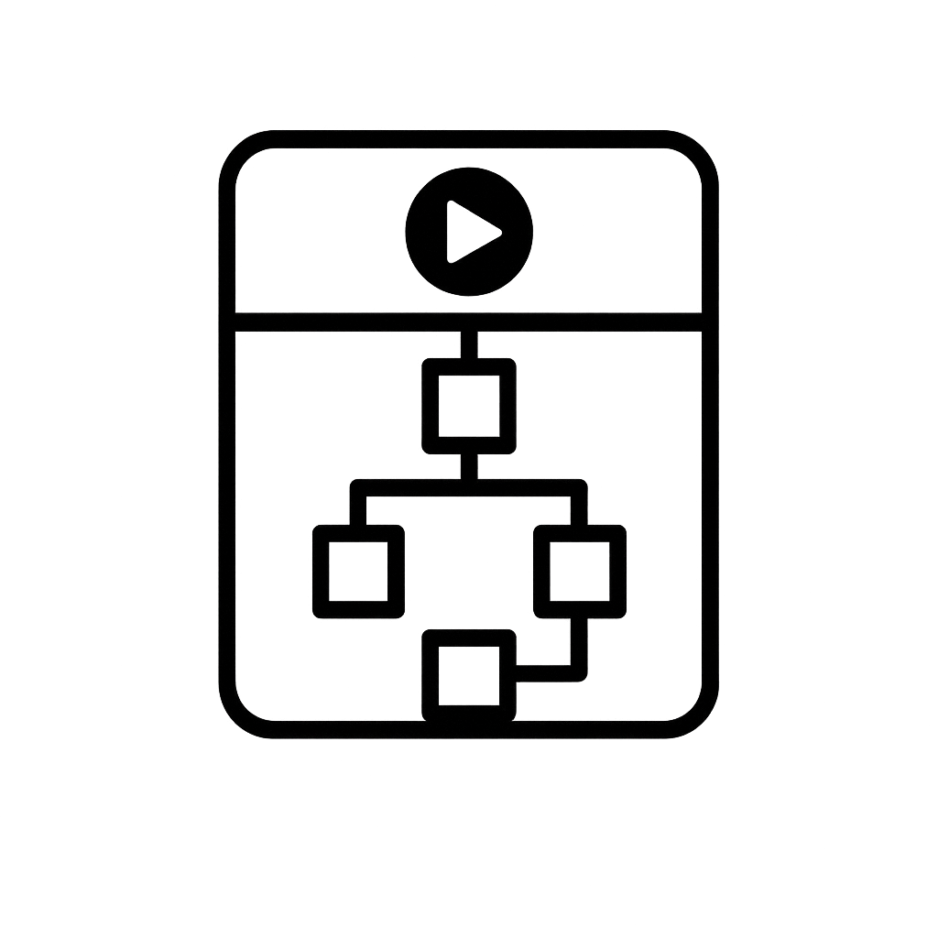


Tagged Information Generation
Explanation Interface Generation
50 Correct
explanations
COT
Dataset
LLM
Tags
iCoT
450 Incorrect
explanations
LLM
Interface Template Design
iCoding
iGraph
Interface template

